Slide 1
MURI Update
Aaron Holsteen & Mark Brongersma
September 14, 2015

Slide 2
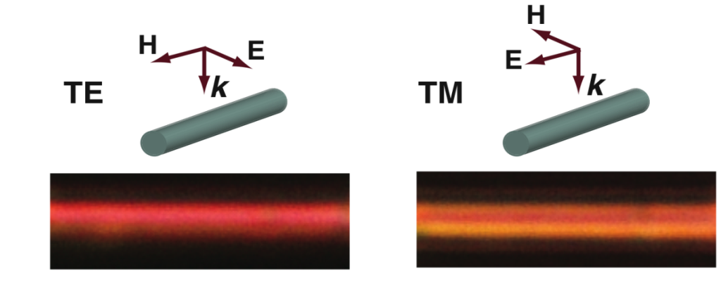
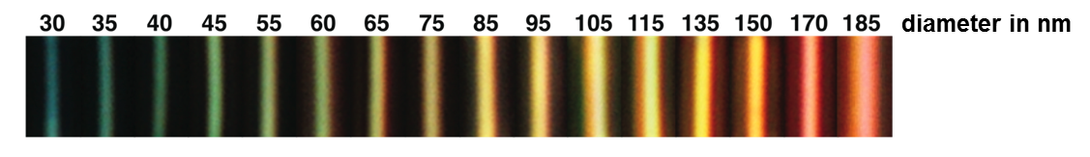
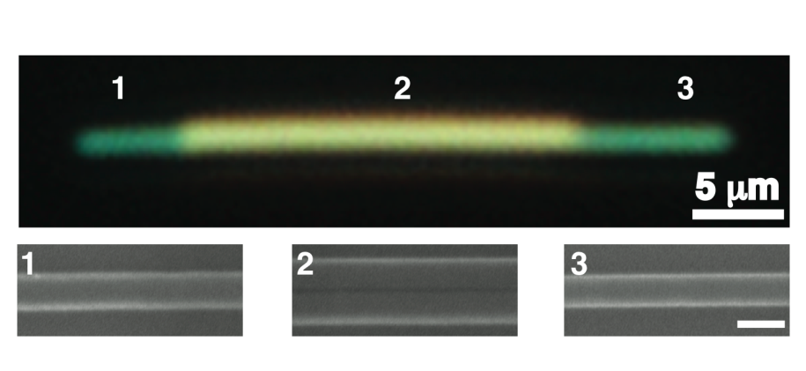
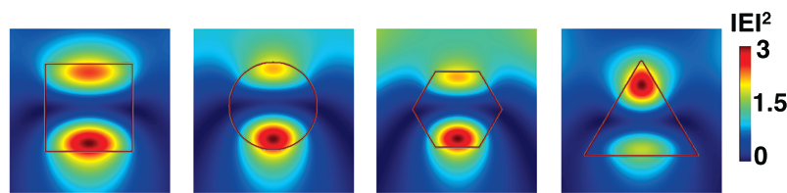
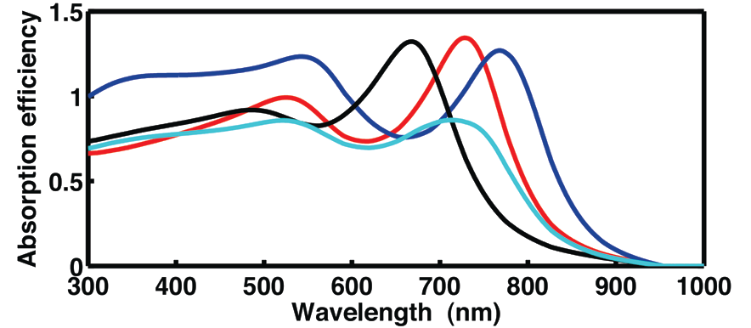
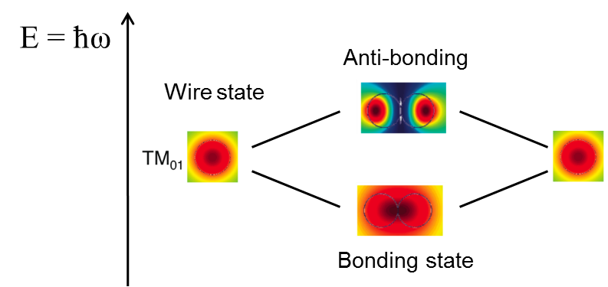
Tunability of Optical Resonances in High Index Nanostructures
Example: Resonances of Si nanowires and beams
Size
Polarization
30 nm
180 nm
Shape
Coupling
130 nm
50nm
Cao, Brongersma et al., Nano Lett., 2649–2654, 10, 2010.
Cao, Brongersma et al., Nano Lett., 10, 439–445 (2010).

Slide 3
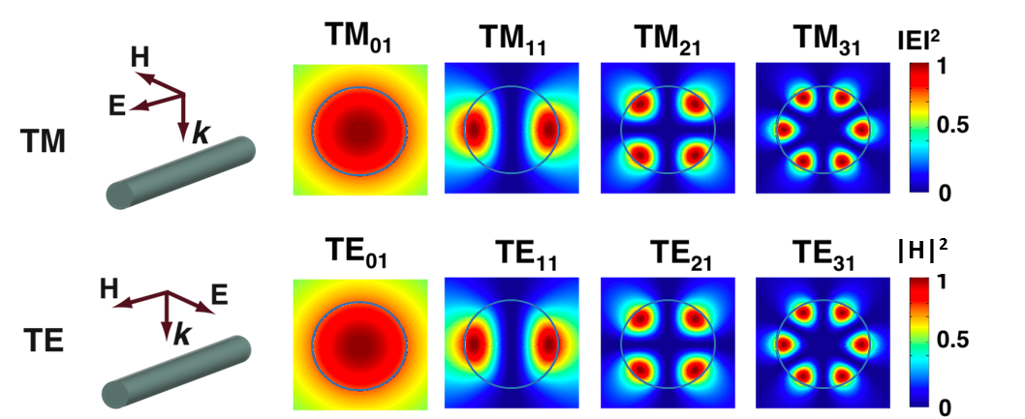
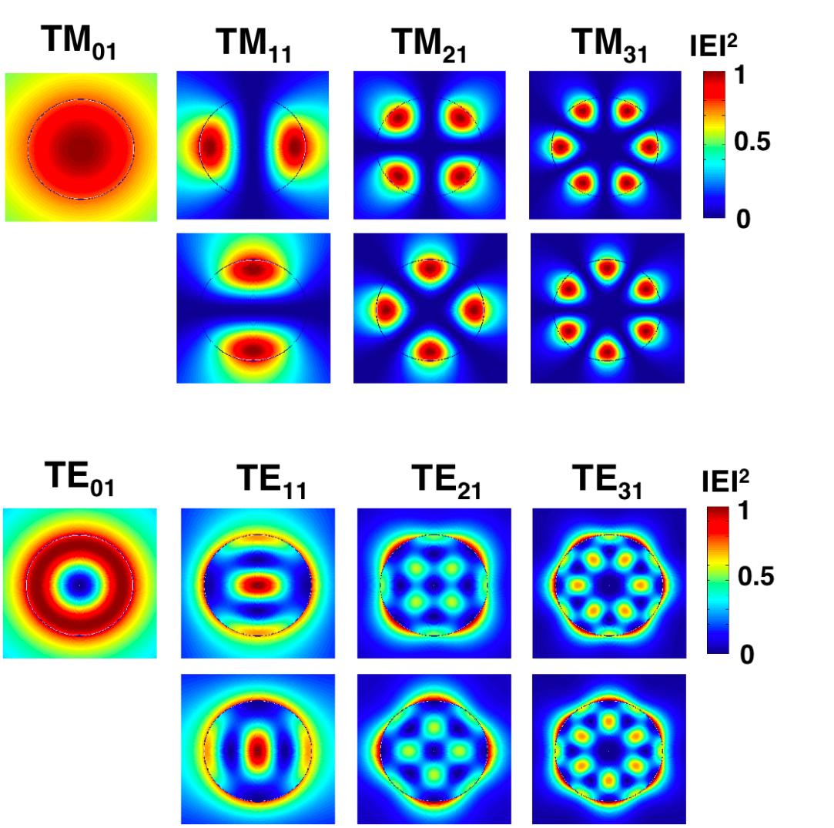

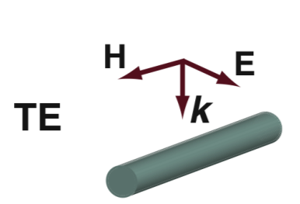
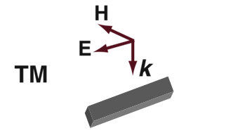
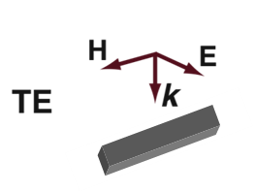
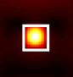
Optical Properties of Dielectric/Semiconductor Structures
• For top-illumination resonances split in TM and TE modes
|H|²
• For 100 nm wide rectangular nanowires, the two lowest order resonances apparent in the visible
TM₁₁
TE₁₁
TE₀₁
TM₀₁
Notes:
M = number of wavelength around the circumference; L is radial order

Slide 4
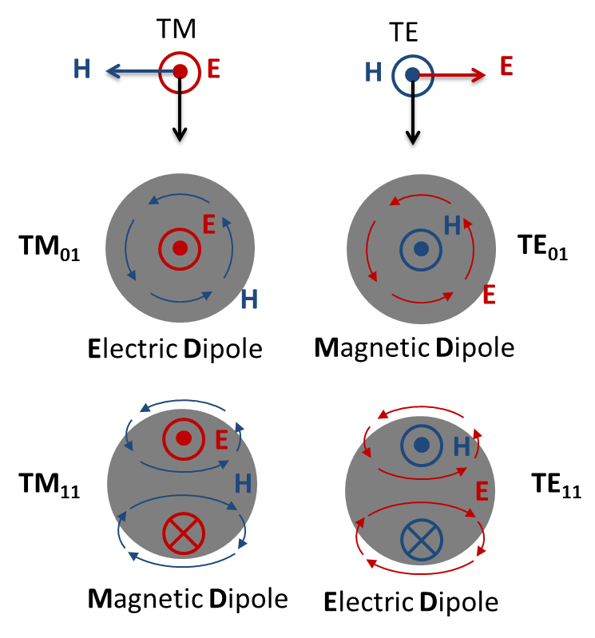
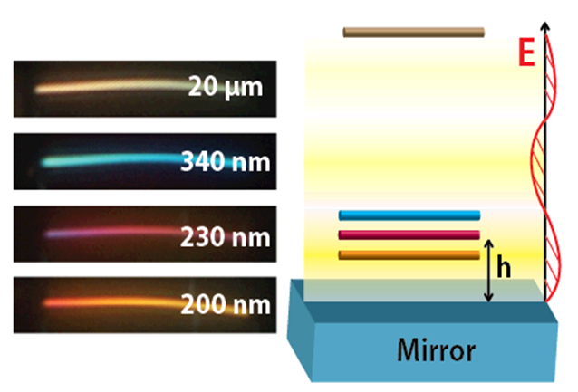

Dipolar nature of TE₀₁ and TE₁₁ modes above a mirror
Tuning Across the Visible
Spectrum
Point Dipole Model
m = α_{M}H
p = α_{E}E
Project Goals:
Understand why these dipolar-like resonances respond the way they do near a mirror
Explore mechanisms to make tunable metasurface devices utilizing these resonances

Slide 5
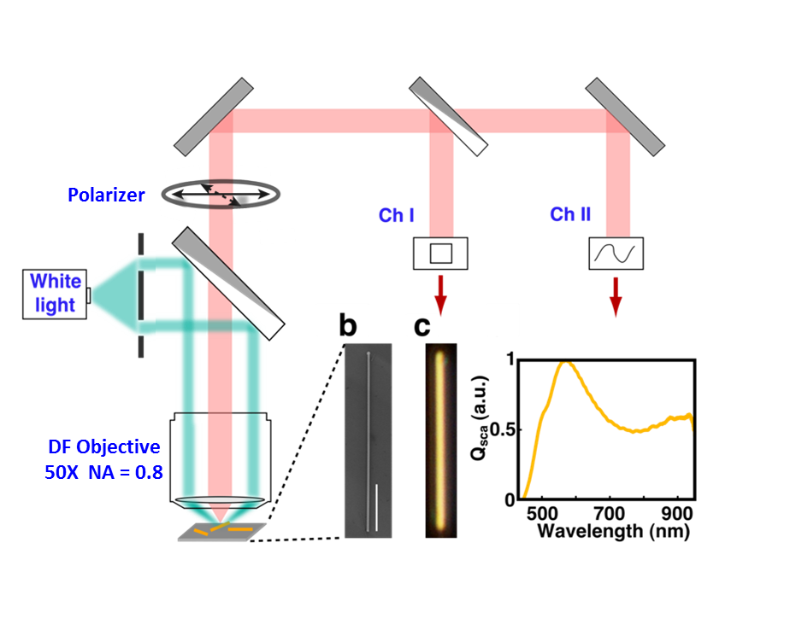
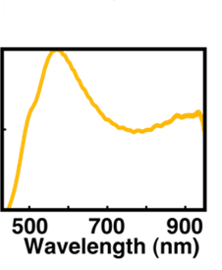
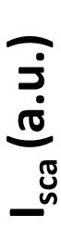
Measuring optical scattering of nanowires
Confocal microscopy and dark field illumination:
Confocal Pinhole
Source
I (a.u.)
Measurement
Scattering Spectra
SiNW
Mirror
Dark Field Image
Notes:
Now that I have explained the nature of the optical modes supported in Si NWs, let me describe the experimental approach to examine the optical properties of these structures.
Deposit nanostructure: VLS, sonication, and casting or EBL and RIE fabrication
Optical DF imaging
Confocal optical spectrometry via a diffraction grating and areal ccd
Measure the Scattering Cross-section

Slide 6
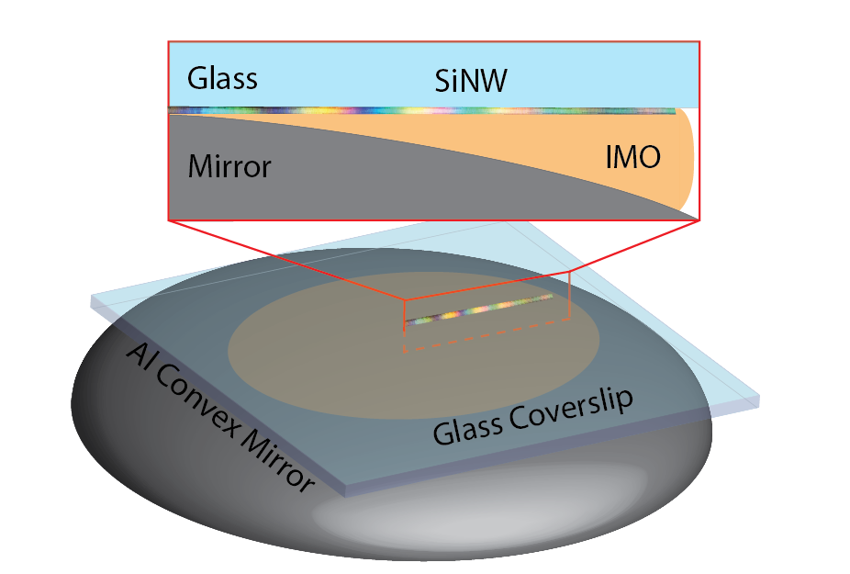

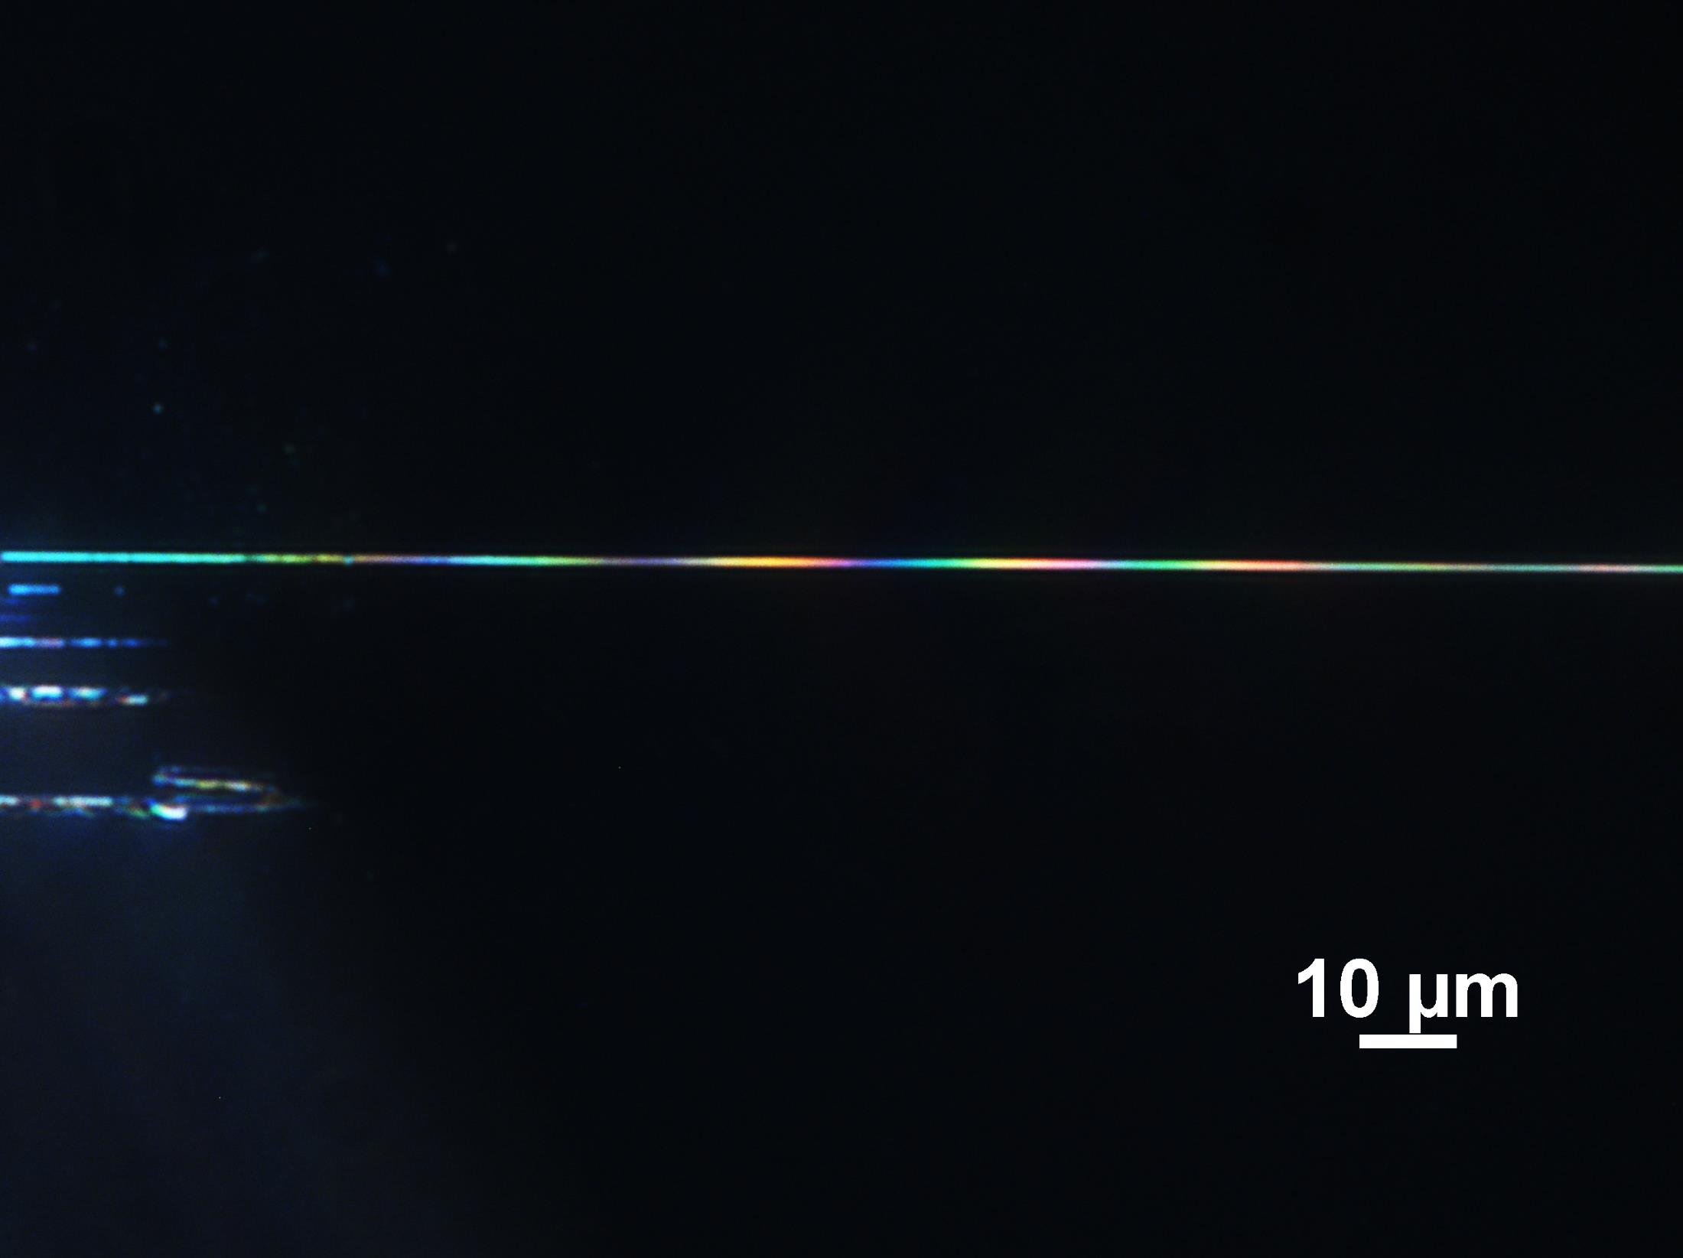
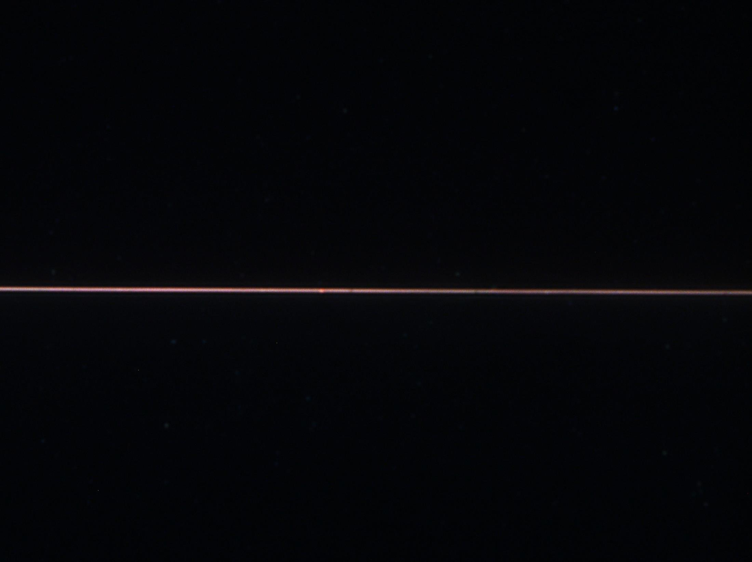
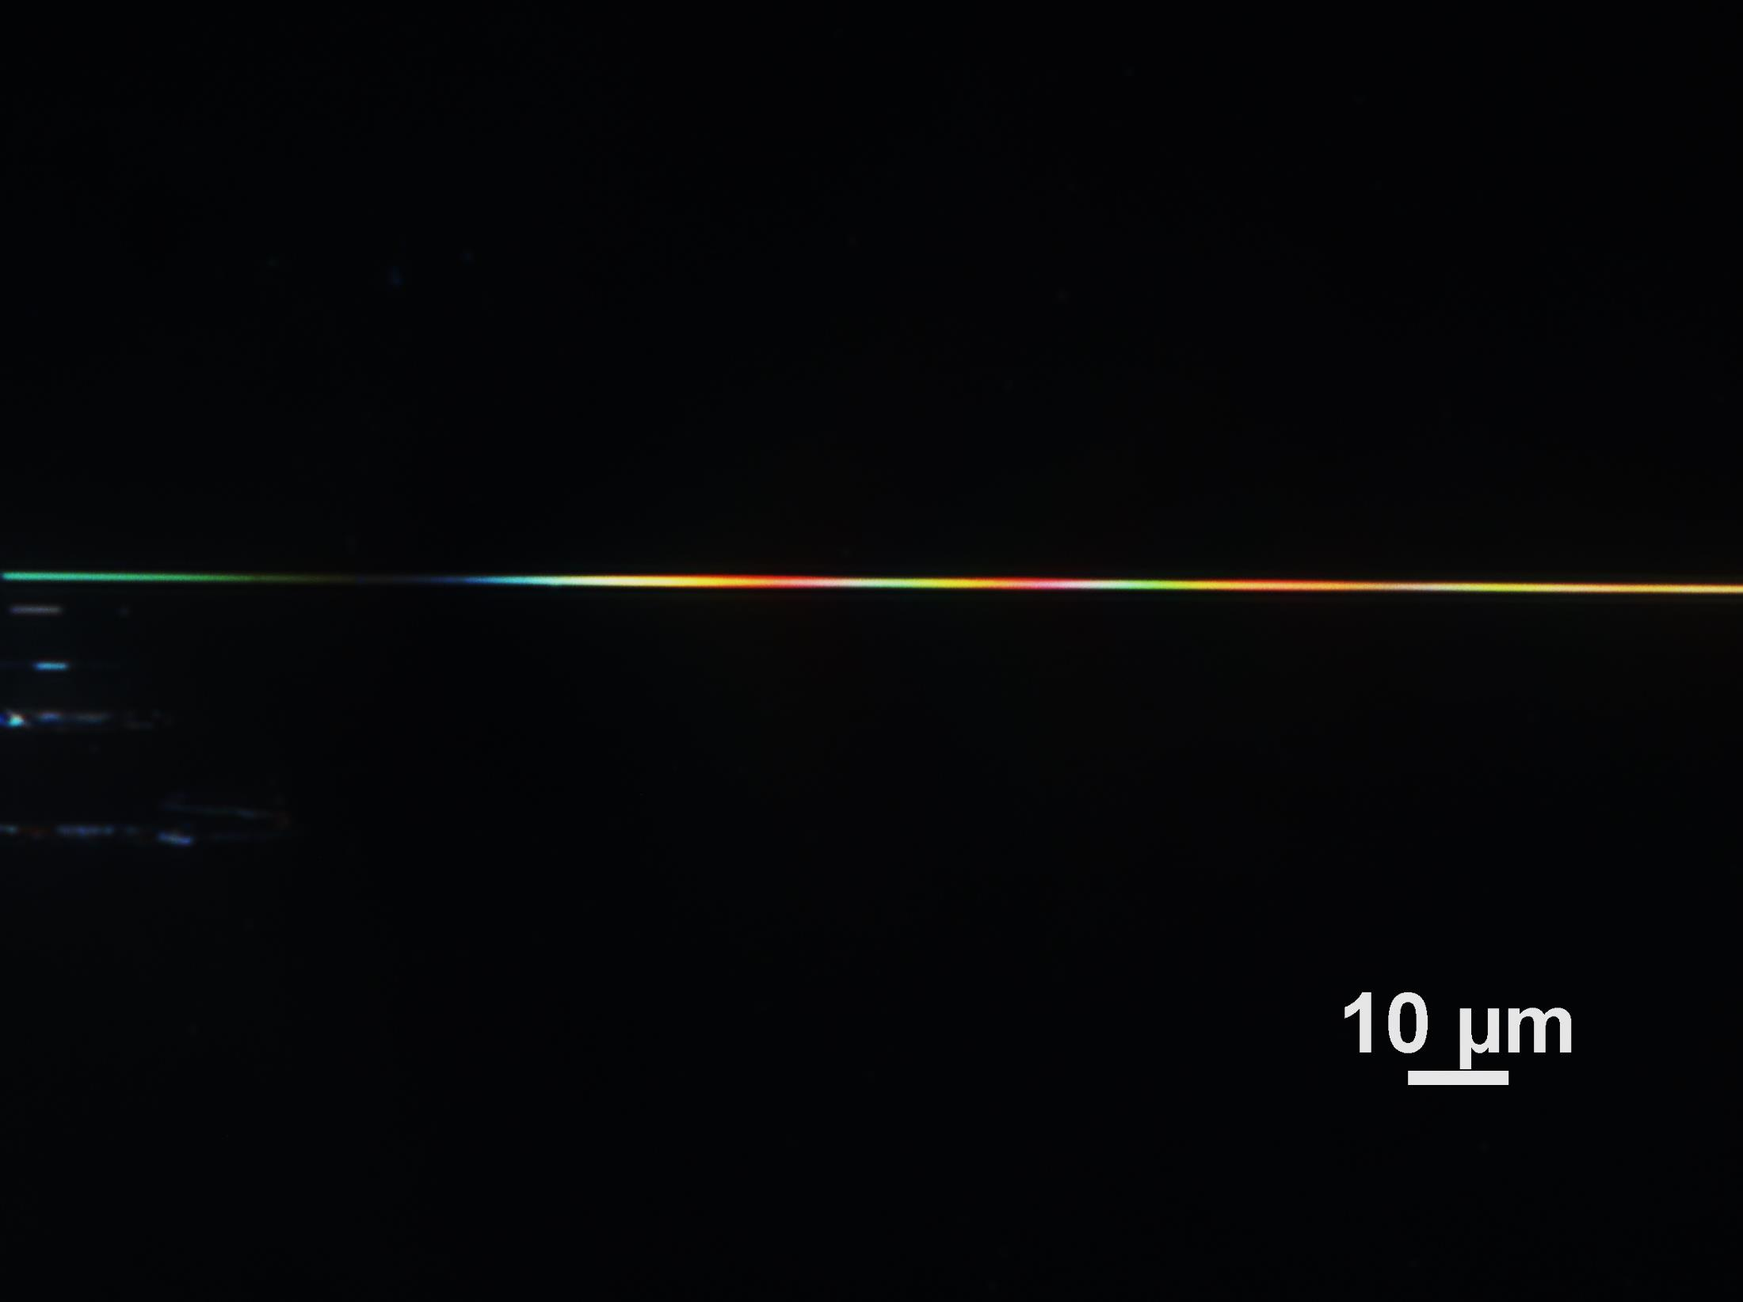
New approach to examine the modulation of excited optical
resonances from long silicon nanowires:
Nanowire Size:
W = 80 nm , H = 105 nm
Without Mirror
With Mirror
TE
TM
20 μm
Both polarizations exhibit resonances that are tunable across the visible spectrum
with changes of the height above a mirror.

Slide 7
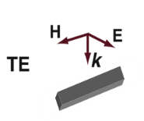
Experimental spectral results for the TE Polarization
Scattering Spectra Without Mirror
TE₁₁
Optical
Image
TE₀₁
Two resonances are clearly visible as the nanowire gets further away from the mirror, the Mie-like resonances
Fast modulations with height ~100-200 nm present
Slow envelope modulations ~1000 nm present

Slide 8
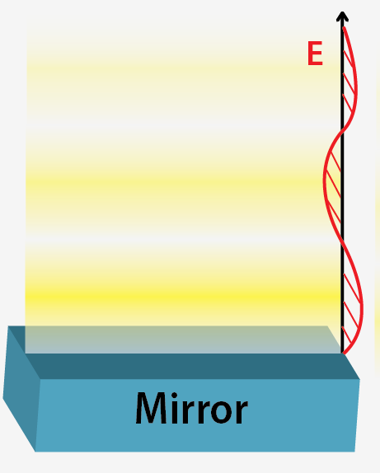
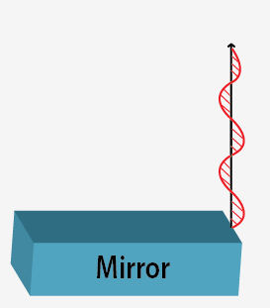

Predicting the height variations in the scattered light intensity
Incident Field
Standing Field Above Mirror
Efficiency
NW
η_{ext} ~ (E_{inc})²
p
Scattered Field
NW
η_{col} ~ (E_{scat})²
Total Field
η_{tot} ~ η_{col} * η_{ext}

Slide 9
Separate Excitation of TE₀₁ and TE₁₁ Modes above a mirror
TE₁₁
TE₀₁

Slide 10
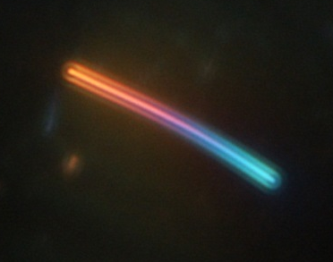
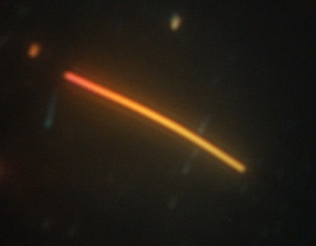
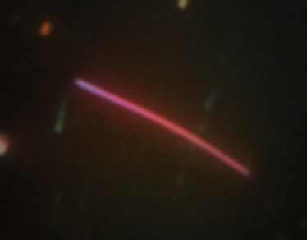


Concluding Remarks
Similar results exist for the TM polarization, with broadband tunability
Next Steps are to look at ways to mechanically control the height to enable active metasurface devices

Slide 11
Comparison of Experimental and Simulated Light Scattering,
TE Polarization

Slide 12
Comparison of Experimental and Simulated Light Scattering,
TM Polarization
12

