Slide 1
High Efficiency Mid-Infrared Flat Lenses Based on Reflectarrays and MEMS Scanning Devices
MURI Update on September 16, 2015
Shuyan Zhang,
F. Aieta, I. Gabay, A. She, T. Mansuripur, R. Khorasaninejad, D. Rousso, F. Capasso
(Harvard University)
M. H. Kim and N. Yu
(Columbia University)
R. Tapashree, I. W. Jung, D. Lopez
(Argonne National Laboratory)

Slide 2
Our Goal
Design & fabricate a flat lens in the mid-ir (4.6 μm):
  High focusing efficiency
  Simple fabrication steps
  Polarization independent
  CMOS compatible: large scale applications
  MEMS based SLMs

Slide 3
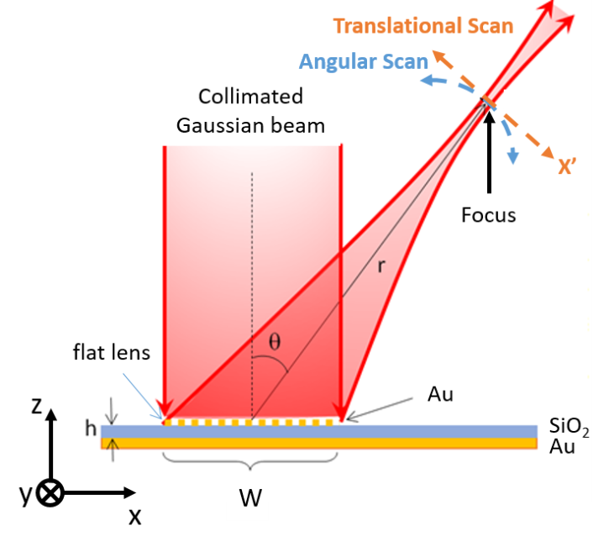
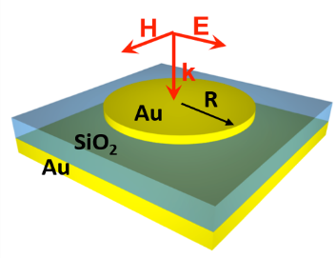
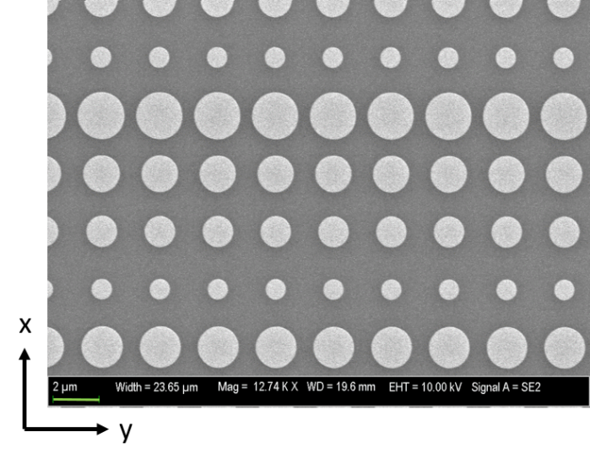

Design & Fabrication
Reflection mode:
Focusing into a line at an angle like cylindrical lens
Future: demonstration of spherical lens functionality
Design principles:
$$φ_{total}\left(x\right)=φ_{focus}\left(x\right)+φ_{deflect}\left(x\right)$$
Fabrication techniques:
E-beam evaporation, PECVD, deep-UV lithography
Materials: Au and SiO₂
Design parameters:
D=3.08 mm (size of lens, 1233 antennas)
θ=45º (beaming angle), h=400 nm
r=4 cm (focal distance)

Slide 4
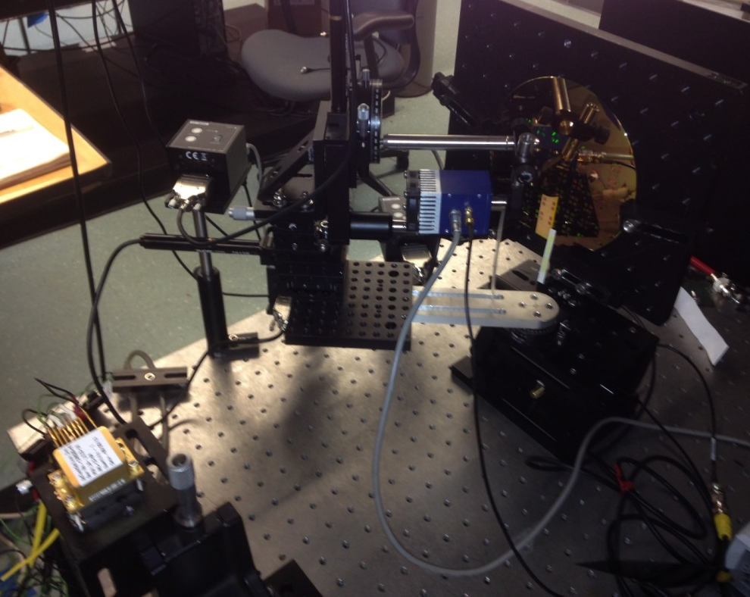
Experimental Setup
Scanning
Motorized rotational & translational stages
Lens
Multiple lenses on a 6-inch wafer
Signal collection
Lock-in amplifier PC
Detector
TE-cooled detector 50 µm pinhole
Source
Fabry-Perot QCL 4.6 μm

Slide 5
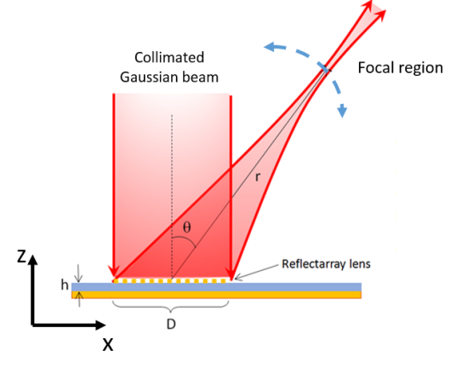
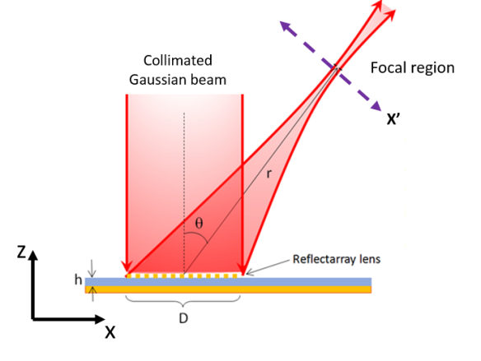
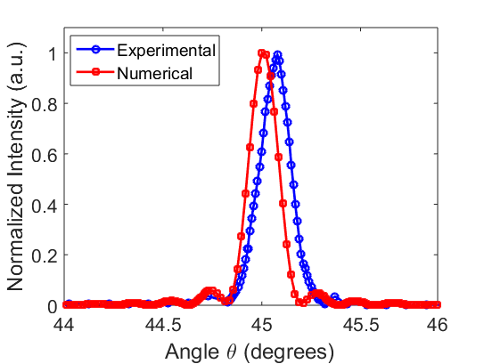
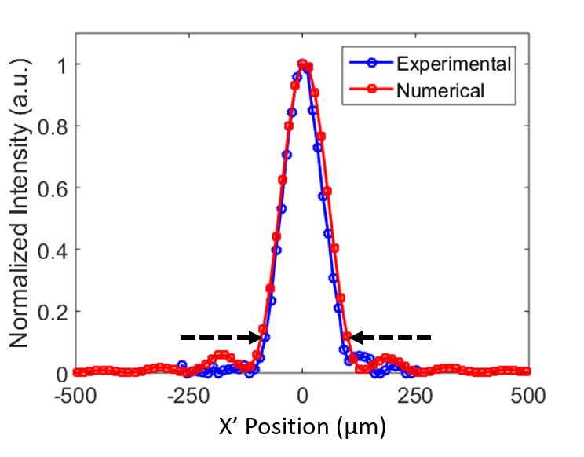
Experiment vs Simulation
Angle scan:
X’ Scan:
Full beam waist @ 1/e² = 185 μm

Slide 6
Conclusion
Summary of features
  Metasurface based flat lens that focuses ir light from 3 mm beam waist down to 185 μm beam waist
  The measured focusing efficiency is 72% and the simulated efficiency is 80%.
Outlook
  Applications in ir imaging, detection, and focused beam steering
  MEMS scanners integrated with flat optics for compact imaging/scanning probes: collaboration with D. Lopez Group at Argonne National Lab (world leader in MEMS Technology)

Slide 7
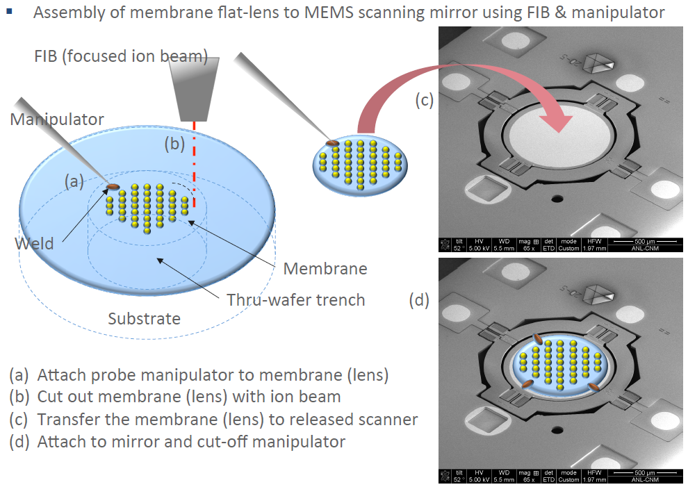
Lens on membrane
Slide adapted from Il Woong Jung (Argonne National Laboratory)

Slide 8
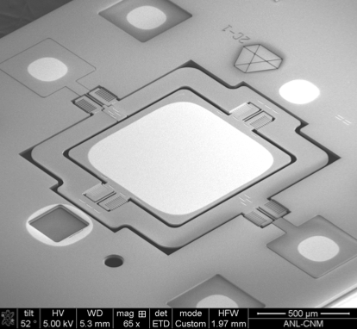
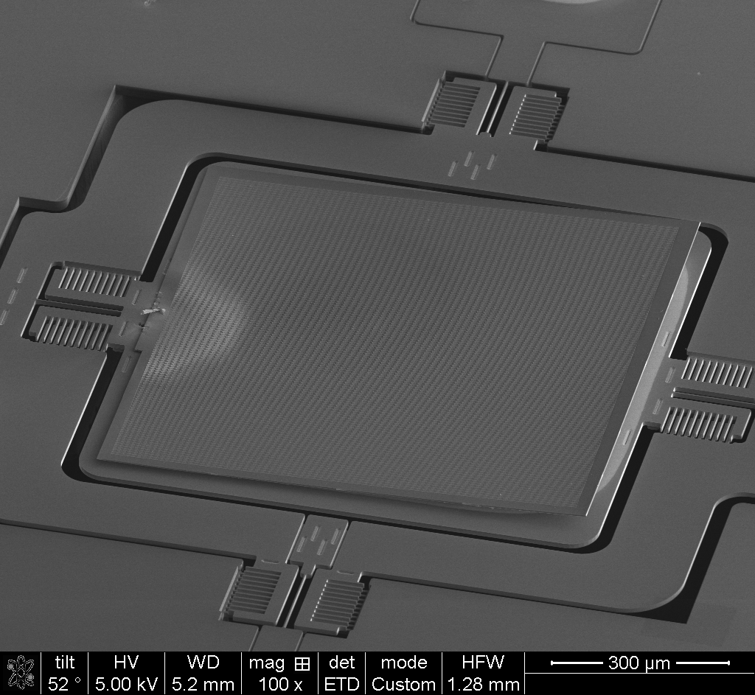
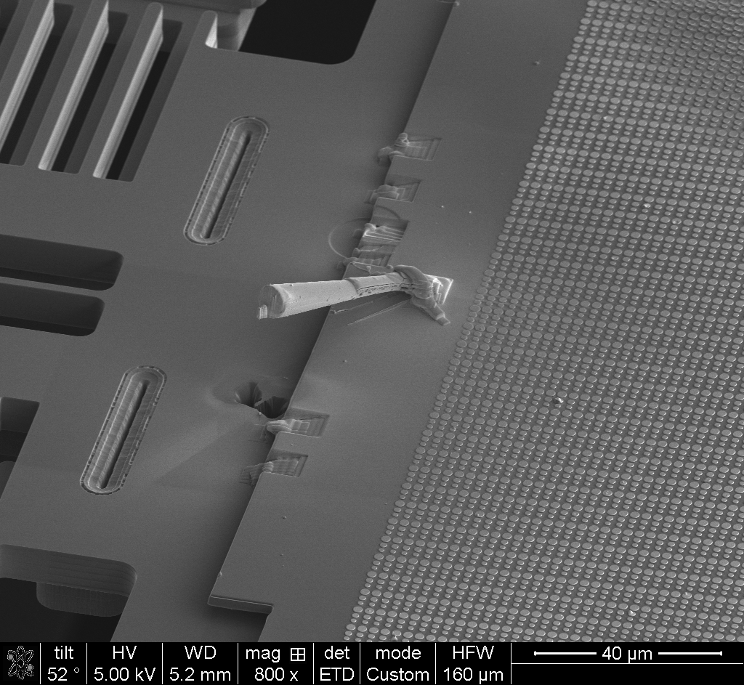
Nano-welding of flat lens on MEMS
bare MEMS
MEMS with lens
900 μm
MEMS with lens
weldings
probe
Slide adapted from Roy Tapashree
(Argonne National Laboratory)

Slide 9
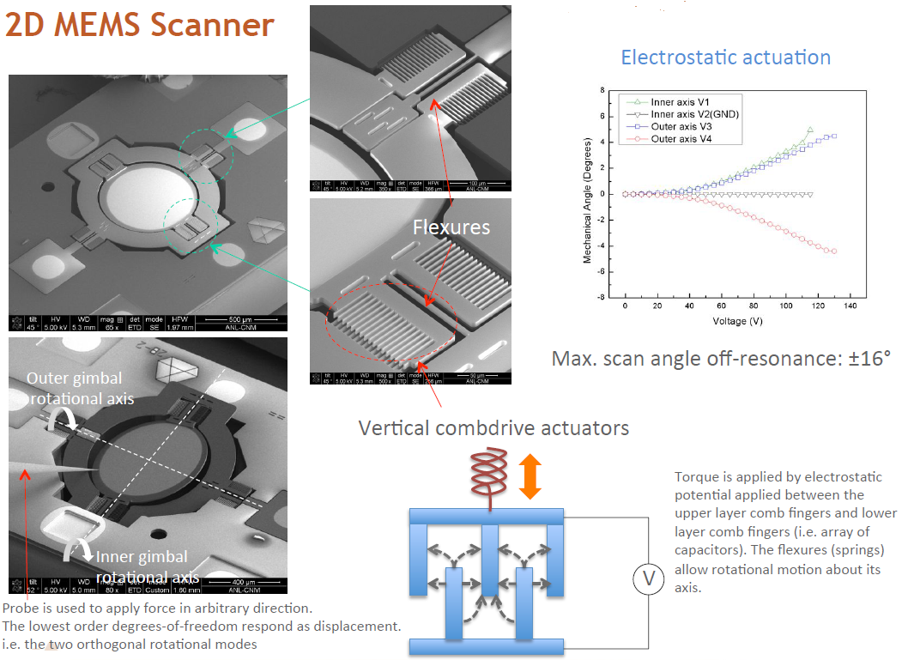
Slide adapted from Il Woong Jung (Argonne National Laboratory)

Slide 10
appendix

Slide 11
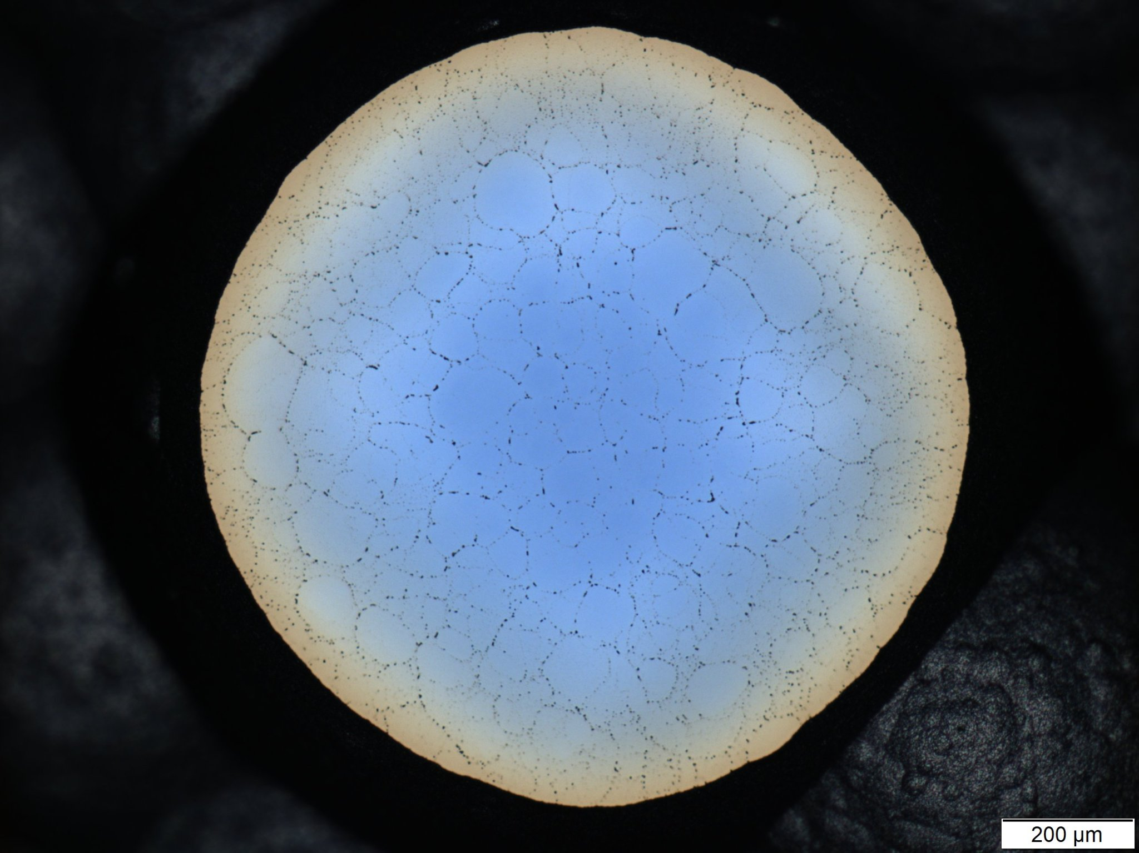
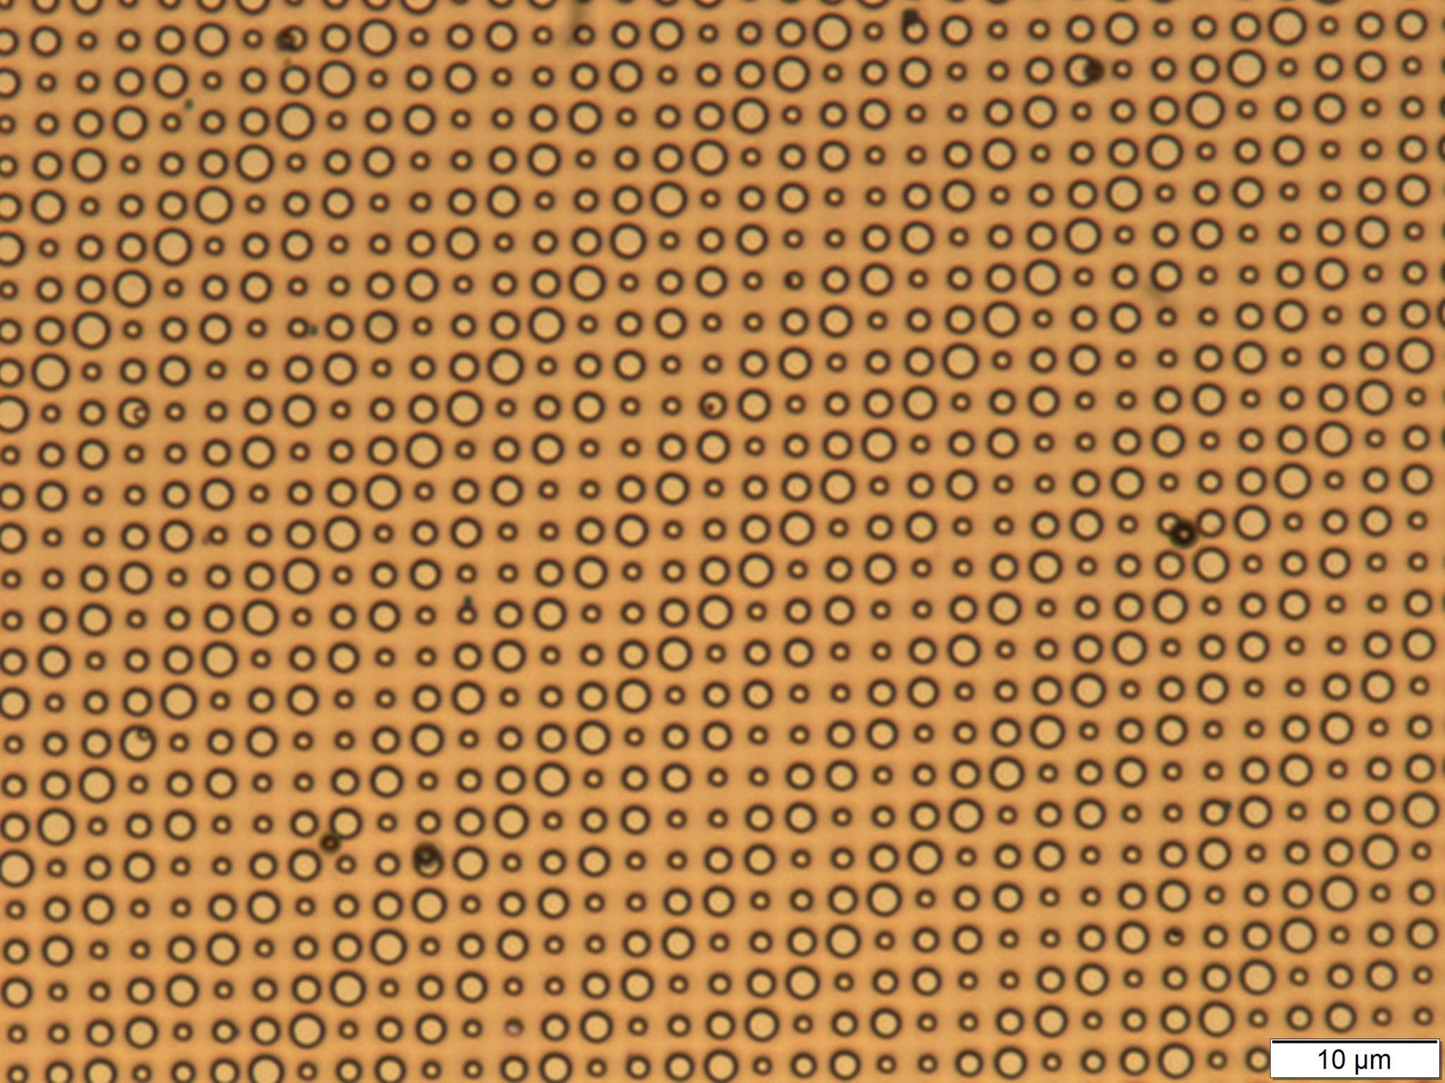
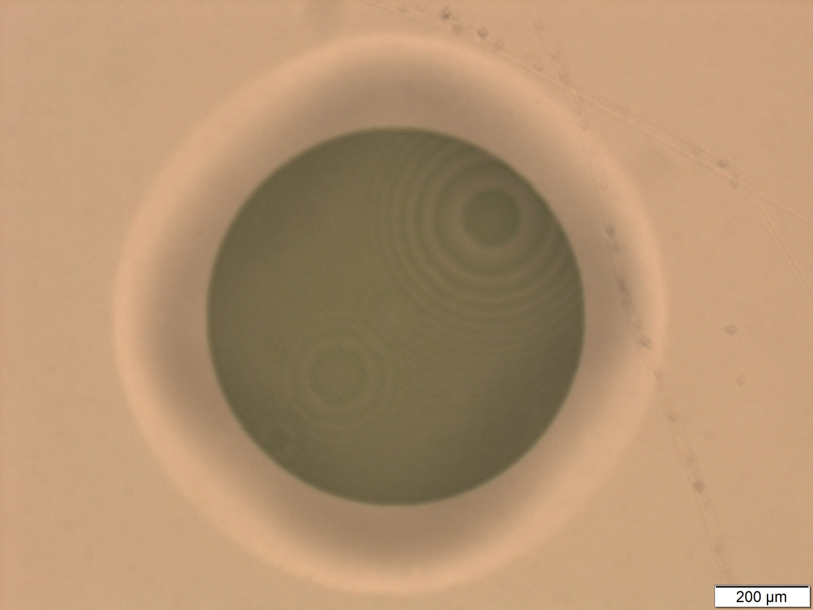
Making a flat lens membrane
Backside
Au 50 nm
SiO2 400 nm
Au 200 nm
Silicon 2000 nm
SiO2 200 nm
Silicon 600000 nm
SiO2 110 nm
membrane 2.85 um
XeF₂
1190 um
Frontside
after etch
Mag 100 x
NA 0.9
Frontside
800 um
1190 um

Slide 12
