Slide 1
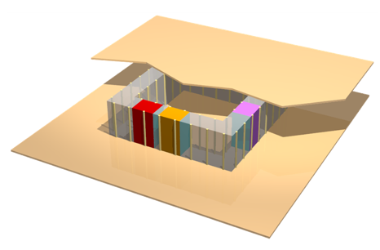
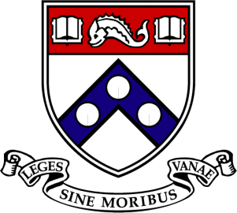
Plasmonic Metasurface Using Structural Dispersion: Metasurface Metatronics
Yue Li, Cristian D. Giovampaola, and Nader Engheta
Dept. of Electrical and Systems Engineering
University of Pennsylvania
Philadelphia, PA, USA

Slide 2
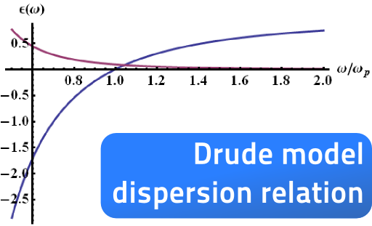
Plasmonics: material Dispersion
Drude dispersion in optical, NIR, MIR domains
P. B. Johnson and R.W. Christy, Phys. Rev. B 6, 4370 (1972).

Slide 3
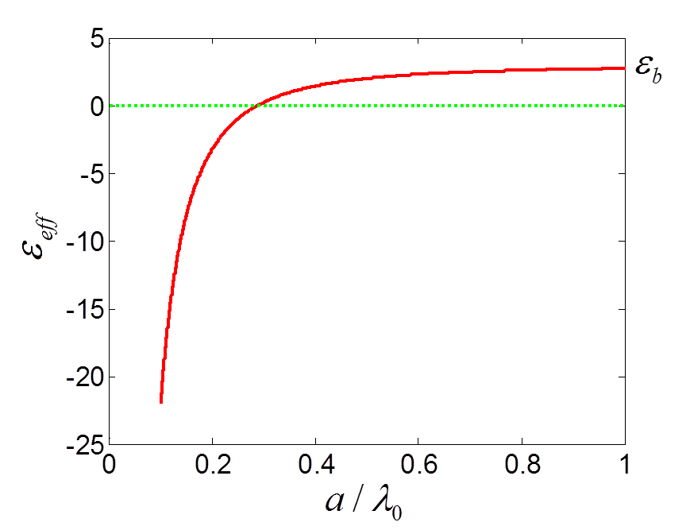

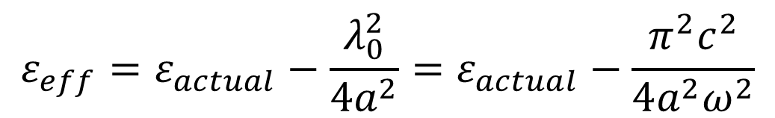

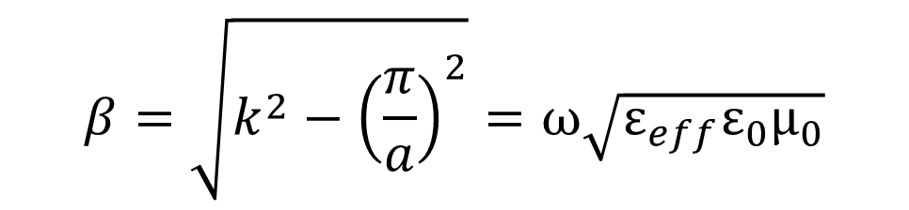
Structural Dispersion:
TE₁₀ mode:
$$ε_{actual}$$
$$β=\sqrt{k^{2}−{\left(\frac{π}{a}\right)}^{2}}=ω\sqrt{ε_{eff}{ε_{0}μ}_{0}}$$
$$k=ω\sqrt{ε_{actual}{ε_{0}μ}_{0}}$$
Waveguide metasurfaces
$$ε_{eff}=ε_{actual}−\frac{λ_{0}^{2}}{4a^{2}}=ε_{actual}−\frac{π^{2}c^{2}}{4a^{2}ω^{2}}$$
W. Rotman, IEEE TAP, (1962).

Slide 4
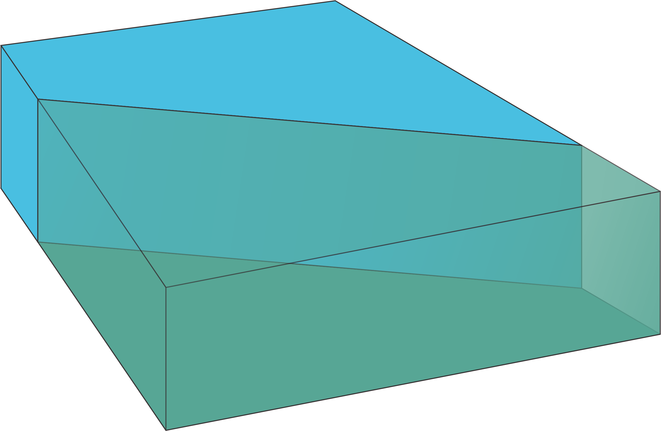
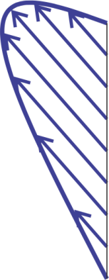
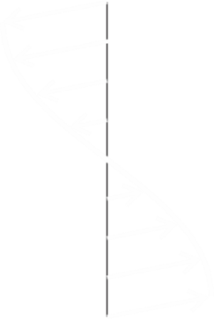
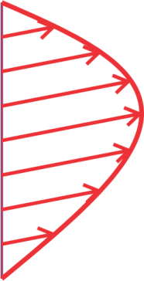
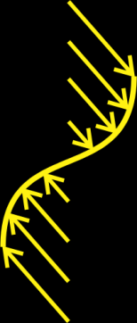
Waveguide metasurfaces: mode coupling
TM₁₀
TE₁₀

Slide 5
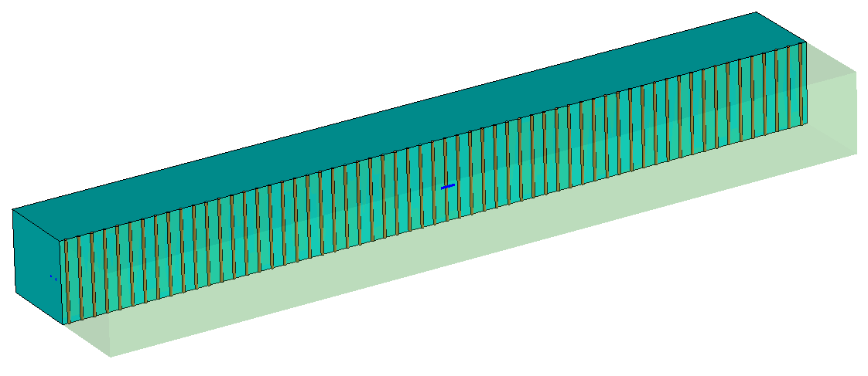
Plasmonic properties using WG metasurfaces
a=0.2887λ₀
Short electric dipole located l₀/20 from the interface and parallel to it
SPP in waveguide metasurfaces

Slide 6
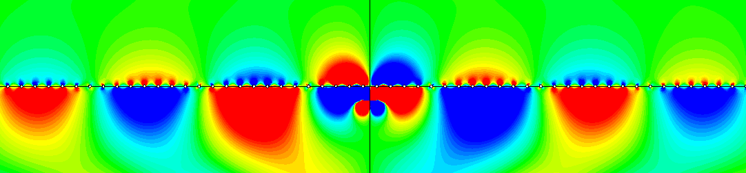
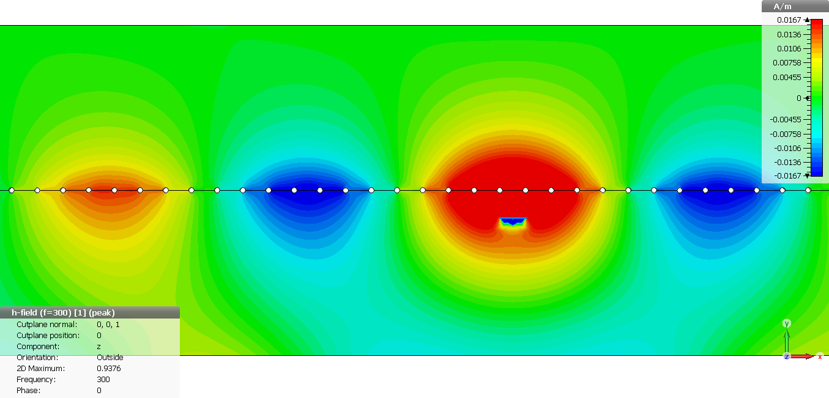
SPP using waveguide metasurfaces
Ey distribution:
λ_{SPP} = 0.73 m

Slide 7
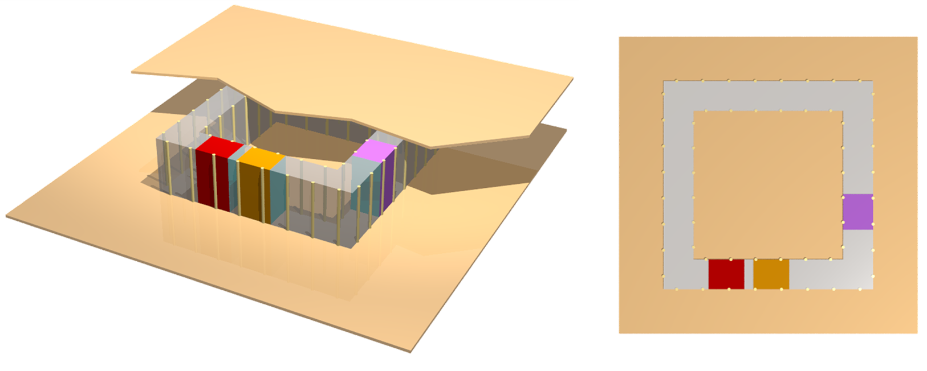
Metatronics using WG metasurfaces
D-dot wires
R
C
L
Lumped components
ENZ host

Slide 8
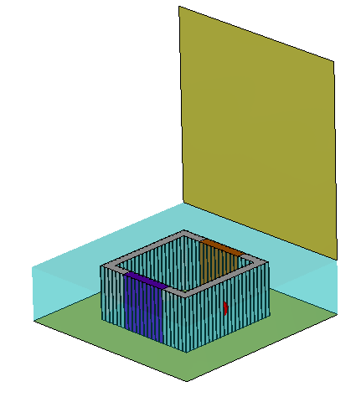
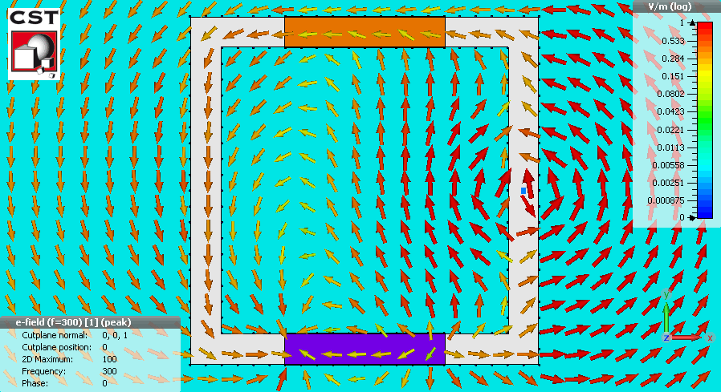
Circuit using WG metasurfaces
l=0.5λ₀
l=0.5λ₀
Capacitor
Inductor
a=0.2887λ₀
Effective air groove
Effective ENZ host

Slide 9
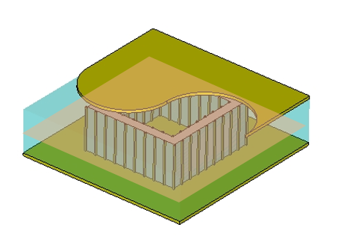
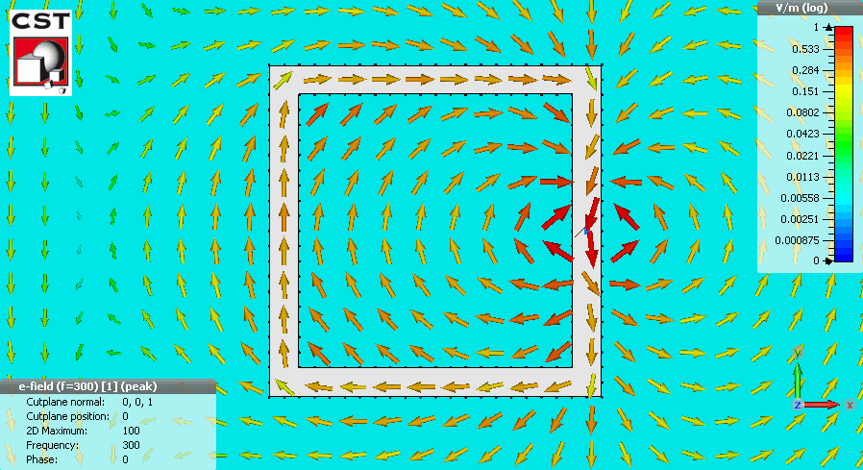
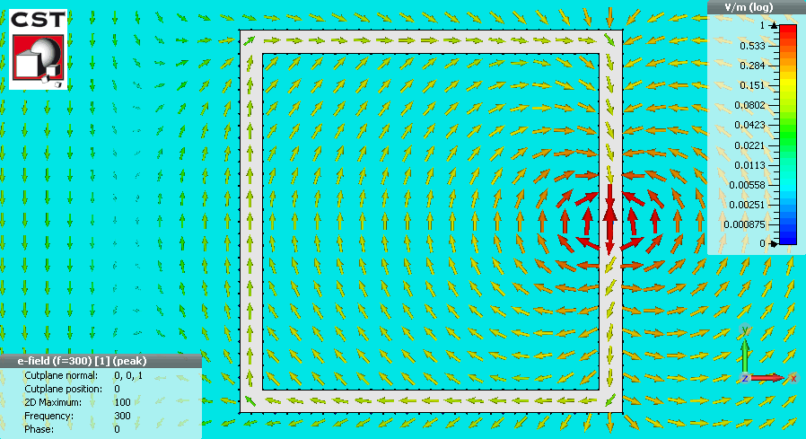
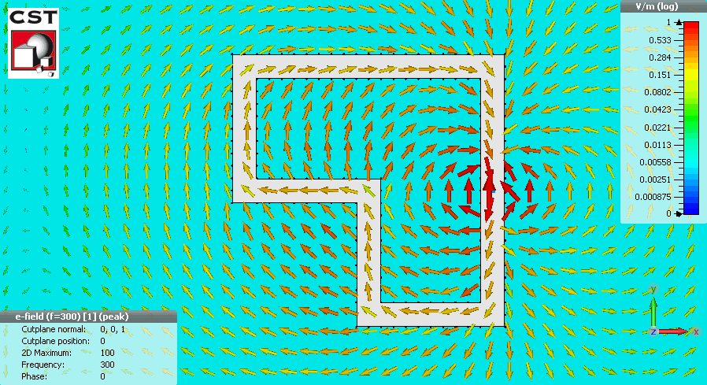
D-dot wires
E vector
Hz magnitude and phase
λ₀* λ₀
1.5λ₀* 1.5λ₀
Different shape

Slide 10
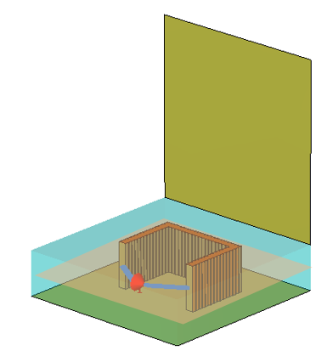
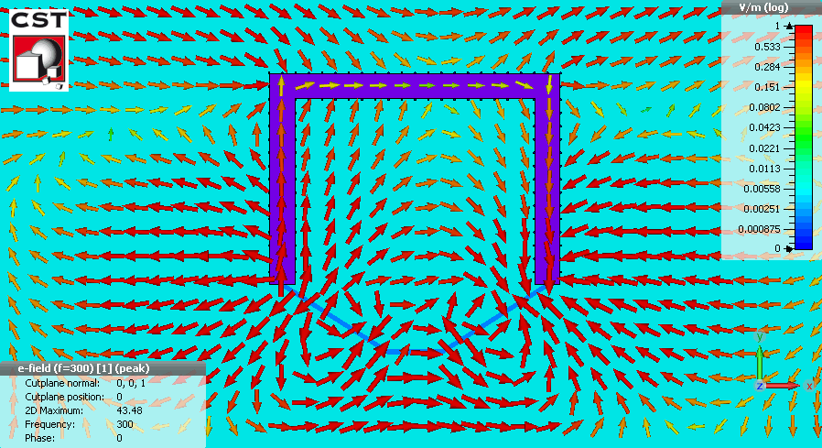
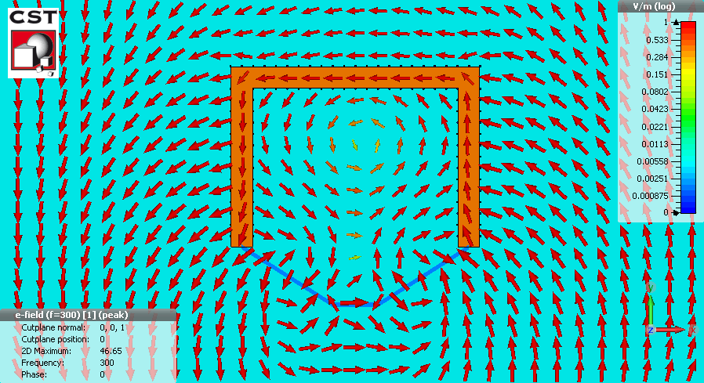
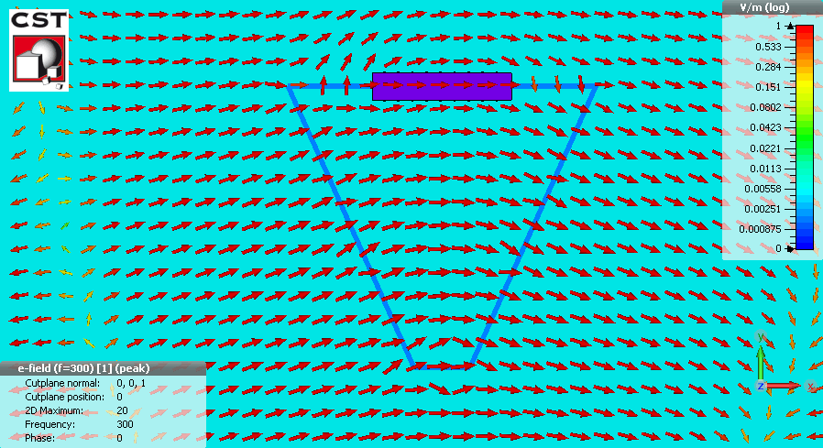
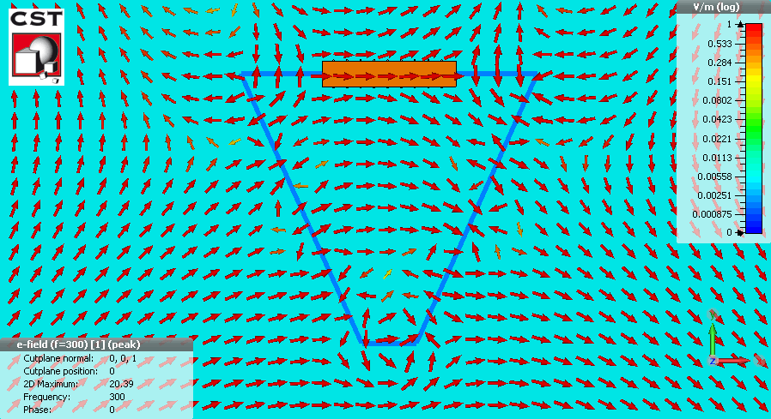
Lumped components
E vector distribution:
l=2.5λ₀ and 0.5λ₀
Inductors
Capacitors

Slide 11
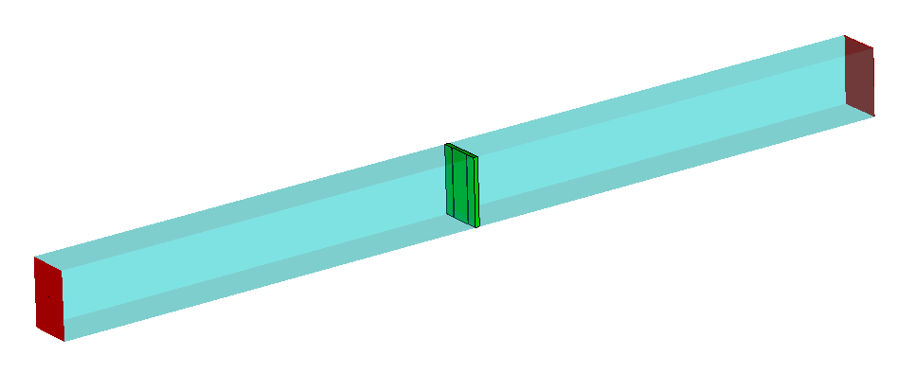

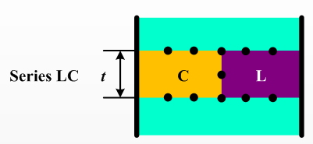
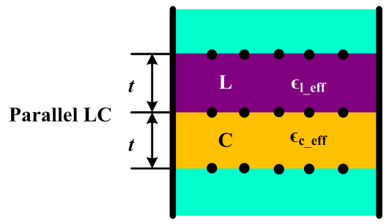
LC resonators uisng WG metasurface
C
L
L
C

Slide 12
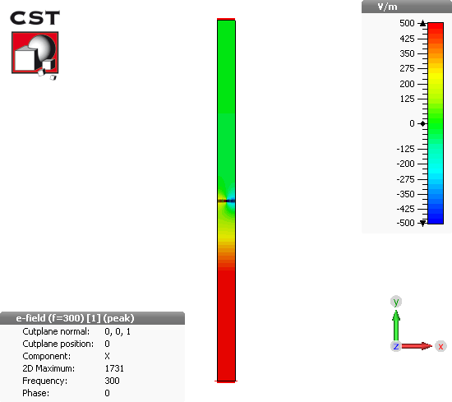
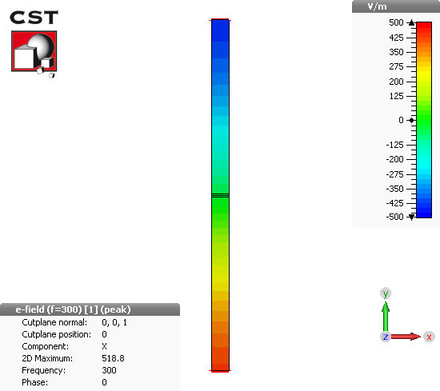
LC resonator in WG metasurfaces
Series LC
Parallel LC

Slide 13
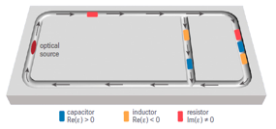
Conclusion and future work
Plasmonics
Material dispersion
Metasurface metatronics
Waveguide metasurfaces
Metasurface Metatronics: D-dot wires, inductors, capacitors, LC resonators; (already have)
Matching circuits, filters, and other complex metasurface circuit; (in future)
Test bed for optical metatronic circuits at a lower frequency. (in future)

Slide 14
Thank you very much!

