Slide 1
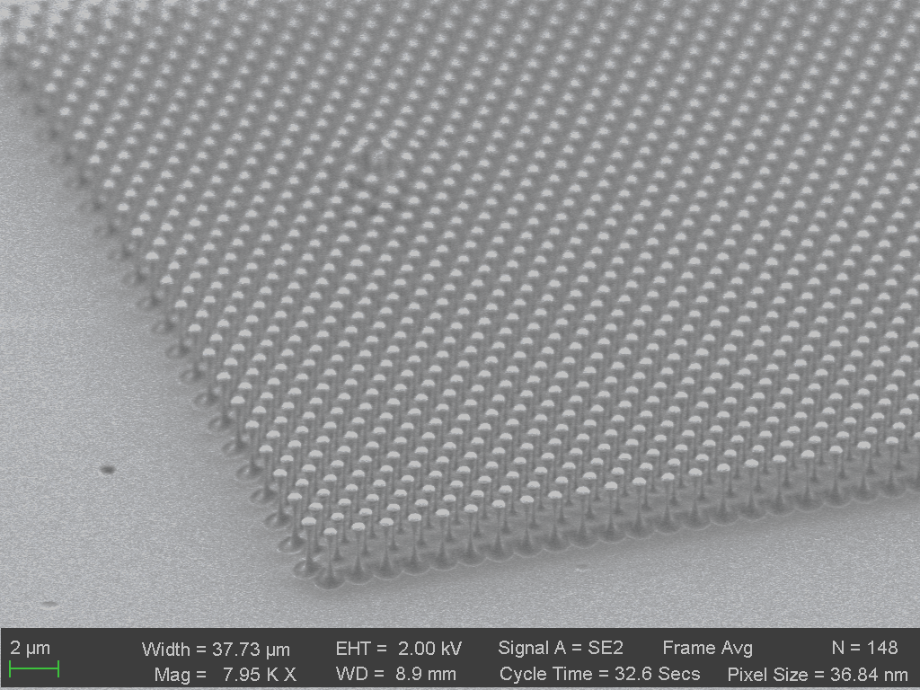
Metasurfaces from
Bulk Diamond
Haig Atikian, Xiao Xiong & Marko Loncar
Laboratory for Nanoscale Optics
Loncar Group
School of Engineering and Applied Sciences, Harvard University
9 Oxford Street, Cambridge, MA 02138

Slide 2
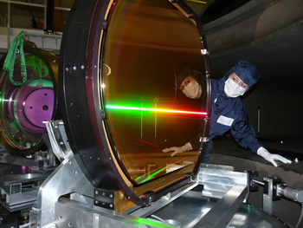
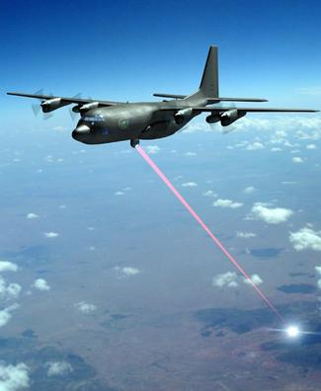
Laser Damage Threshold
Laser light can have very high optical intensities
Therefore, laser light often causes laser-induced damage of optical components like mirrors, lens, polarizers. etc.
For various applications, one needs to select optical components with a sufficiently high optical damage threshold (LIDT).
http://www.zmescience.com/science/physics/high-power-laser-hallow-atom-inside-out-0432423/
http://techno-comps.blogspot.com/2011/04/top-five-future-weapons.html

Slide 3
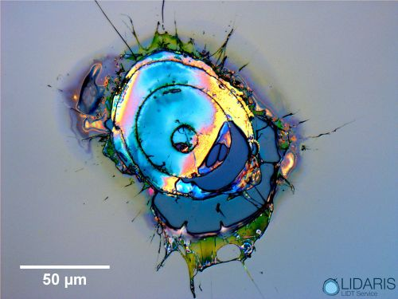
Laser Damage Threshold
Optical damage can arise within a bulk piece of optical material, but also on its surfaces
Surfaces often exhibit a higher density of microscopic defects than bulk material, typically being the site of laser damage.
Damage threshold can depend on the bulk material, as well as surface layers, which could substantially lower the LIDT compared to the bulk.
Power handling capabilities could be improved using bulk substrates with excellent thermal and optical properties (diamond)
https://www.rp-photonics.com/laser_induced_damage.html

Slide 4
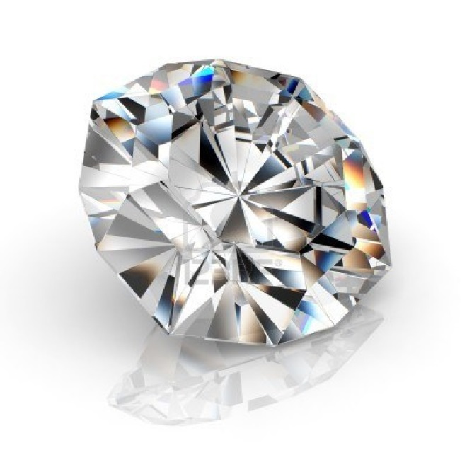
Diamond’s Appeal
Thermal
Highest thermal conductivity
Low thermal expansion
Optical
Wide transmission window
Large refractive index (2.4)
Mechanical
Diamond
…engineer’s best friend
Hardest material
Low mass density
High Young’s modulus
Electrical
Widest bandgap (~5.5eV)
Low dielectric loss
Both n- and p-type doping
Chemical
Chemically inert
Biologically compatible
Surface functionalization possible
Biological

Slide 5
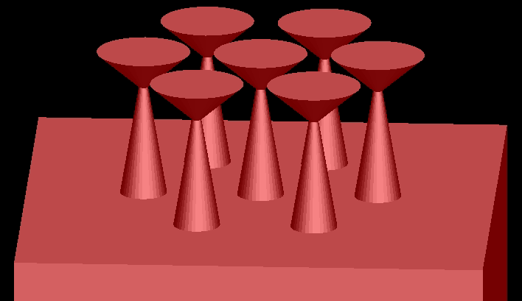
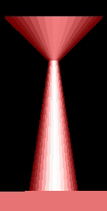
Nanostructure diamond surface
Nanostructure the diamond surface with a structure that has varying diameter width along the vertical direction, to create a metasurface effect from the bulk diamond
r_disc
alpha
h_total
r_min
r_sup
5

Slide 6
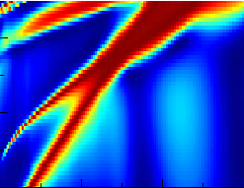
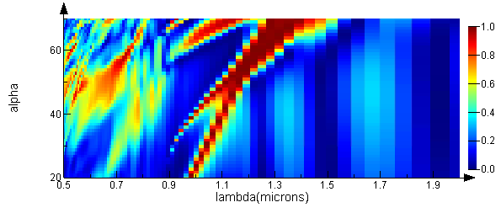
FDTD Simulations Perfect Reflection
h_total
r_disc
～50nm
alpha
r_min
r_sup
h_total=3um
r_min=0.04um
r_sup=0.2um
pitch=1um
r_disc = 0.4um
6

Slide 7
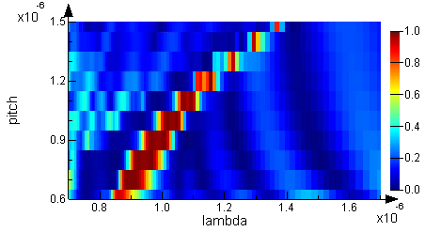
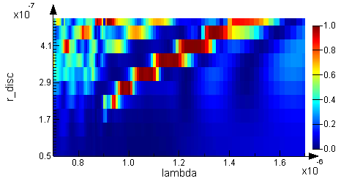
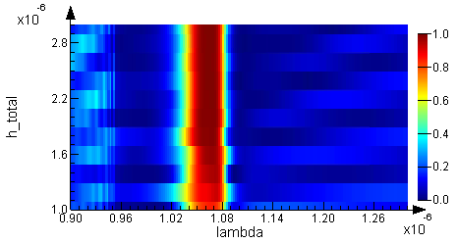
FDTD Simulations Perfect Reflection
Sweep Pitch
Sweep r_disc
Sweep h_total
7

Slide 8
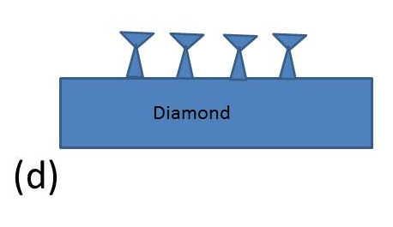
Device fabrication

Slide 9
Device fabrication

Slide 10
Device fabrication

Slide 11
Summary and Outlook
Summary
Fabrication technique improvement to create larger area diamond metasurfaces
Flexible design parameters for tuning bandwidth and operation wavelength
Outlook
Measure experimental results with high intensity lasers to ensure high power handling capabilities

