Slide 1
Lithium Niobate (LN) Metasurface for Second Harmonic Generation
-Fabrication summary
Cheng Wang, Marko Lončar Harvard University
Zhaoyi Li, Nanfang Yu Columbia Unviersity
MURI Conference Call 09/16/15

Slide 2
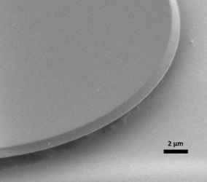
LN Fabrication Capability
Previous fabrication of high quality LN nanostructures
Highest measured Q in microdisk ~ 100,000
Fab method applicable for rings, waveguides, etc.
[1] C. Wang et al., Integrated high quality factor lithium niobate microdisk resonators, Opt. Express (2014).

Slide 3
Fabrication Procedure
FOX-16
FOX-16
FOX-16
LN
LN
LN ridge waveguides
SiO₂
SiO₂
SiO₂
LN
LN
LN
Spin FOX-16 on LNOI substrate (400 nm LN)
E-beam Lithography
RIE w/ Ar⁺ to form an LN ridge waveguide (300 nm etching depth)
a-Si antenna
LN ridge waveguides
LN
FOX-16
LN
SiO₂
SiO₂
SiO₂
LN
LN
LN
E-beam Lithography with Alignment; RIE to form a-Si antenna
Spin on diluted FOX-16 (1:1 with MIBK)
Remove residue FOX-16 and PECVD 75 nm of amorphous Si

Slide 4
a-Si antennae on top of LN waveguides
Initial test done on bulk LN samples
Left: resist defined by e-beam lithography with alignment
Right: Si antennae after removing resist
Notes:
Slightly misaligned; overetched

Slide 5
Future Plan
Fabrication of Si-LN antenna arrays on x-cut LN thin films
Device characterization:
  Butt-coupling with lensed fibers
  Pump with tunable CW telecom laser (1480 – 1680 nm, max power 20 mW)
  SHG light detection using APD
  ~ 100,000 cps with phase mismatched waveguides
  EDFA & OSA available for high power measurements

Slide 6
Q&A
Thank you!

Slide 7
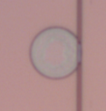



µ-disk Transmission Spectrum (Telecom)
(a)
TE_{94, 01}
TE_{80, 03}
TE_{82, 03}
TE_{81, 03}
TE_{92, 01}
TE_{93, 01}
TE_{86, 02}
TE_{88, 02}
TE_{87, 02}
TE_{85, 02}
Highest measured Q ~ 100,000
in telecom
(b)
(c)
(d)
17.0 pm
Q ~ 88,000
14.8 pm
Q ~ 102,000
35.3 pm
Q ~ 44,000
(e)
(f)
(g)
TE_{88,02} n_{eff} = 1.53
TE_{94,01} n_{eff} = 1.63
TE_{80,03} n_{eff} = 1.42
[1] C. Wang et al., Integrated high quality factor lithium niobate microdisk resonators, Opt. Express (2014).
Notes:
TM modes are not supported in telecom wavelengths since the film is too thin

Slide 8
Integrated LN Photonic Platform
Loaded Q ~ 25,000
Close to critical coupling
Intrinsic Q_{int} ~ 50,000
Highest measured Q on integrated LN platform
~ 65,000
Q = 25,000

Slide 9
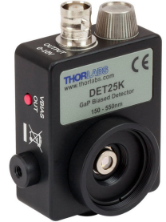

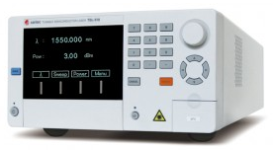
Integrated LN Photonic Platform
Lensed fiber
Photodetector
(APD)
Sample under test
Fiber polarization controller
Tunable Laser

