Slide 1
Harvard- MURI Meeting
September 16, 2015
Prof. Vladimir Shalaev
Prof. Alexandra Boltasseva
Prof. Alexander Kildishev

Slide 2
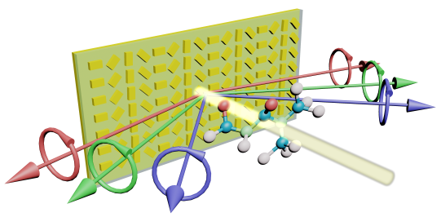
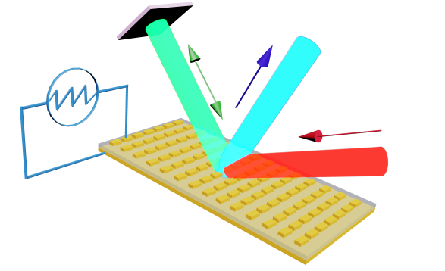

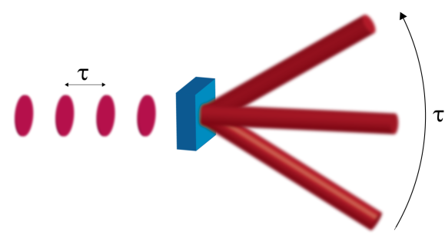
Short Updates
CD Spectrometer
Accepted for Optica:
Amr Shaltout, Jingjing Liu, Alexander Kildishev, Vladimir Shalaev, “Photonic Spin Hall Effect Photonic Spin Hall Effect in Gap-Plasmon Metasurfaces for On-Chip Chiroptical Spectroscopy”, Optica 2(9), 2015
CD Spectrometer
Time-Varying Metasurfaces
Submitted:
Amr Shaltout, Alexander Kildishev, Vladimir Shalaev, “Time-Varying Metasurfaces and Lorentz Non-Reciprocity”, submitted for Optical Materials Express, plasmonics Issue
Time-Varying Metasurfaces
Ultrafast Laser Beam Steering
Metasurfaces feeded by spectral components of ultrashort pulses
τ ~ 100 ps
Theory and simulation completed
Experimentation in progress
Ultrafast Laser Beam Steering

Slide 3
ZrN Metasurfaces
Krishnakali Chaudhuri
Amr Shaltout
Prof. Vladimir Shalaev
Prof. Alexandra Boltasseva

Slide 4
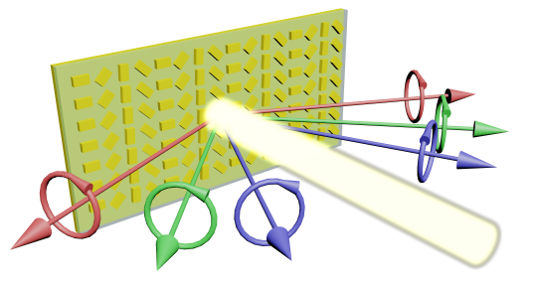
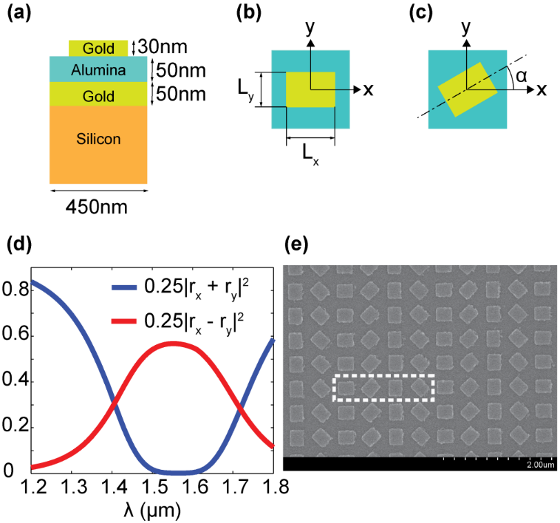
ZrN Metasurface
Replication of already existing phenomena: Photonic Spin Hall effect
PSHE application example : Circular Dichroism Spectrometer*, and all Berry phase based applications.
r_{x}, r_{y} : complex coefficients of reflection of a single nano antenna in x- and y- direction
Theory:
For RCP wave incidence:
For LCP wave incidence :
*Ref: Shaltout et al, “Photonic Spin Hall Effect in Gap-Plasmon Metasurfaces for On-Chip Chiroptical Spectroscopy” submitted (Shalaev Group)

Slide 5
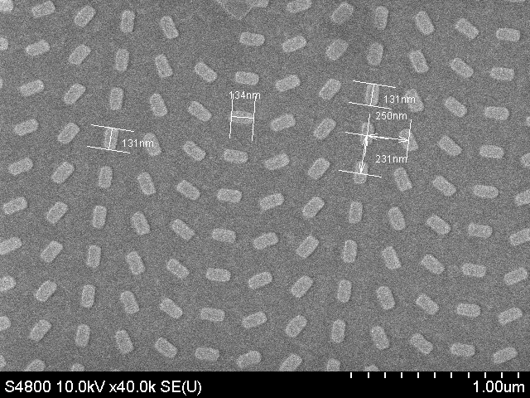
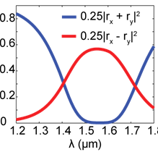
Optimized design of rectangular antenna with ZrN
Px | 250[nm]
Py | 250[nm]
t_sup | 650[nm]
t_mirror | 100[nm]
t_spacer | 50[nm]
t_antenna | 80[nm]
ep_sup | 1
ep_spacer | 4.82
hmax | 50[nm]
t_Si | 500[nm]
W1 | 110[nm]
W2 | 180[nm]
ZrN
80nm
AlScN
50nm
ZrN
100nm
With Au
*
Substrate
250nm
Fabrication issue: Dry etching
  Cl₂/Ar : Slower etch rate, longer etch duration, compromised selectivity with resist
  BCl₃: Very high etch rate, Controlled etching- Experiments ongoing
Extendable into other applications of phase gradient metasurface
*Ref: Shaltout et al, “Photonic Spin Hall Effect in Gap-Plasmon Metasurfaces for On-Chip Chiroptical Spectroscopy” Accepted for Optica (Shalaev Group)

Slide 6
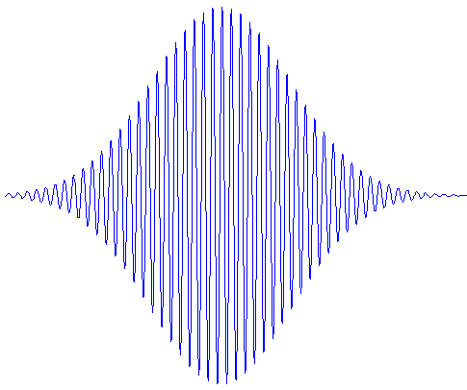
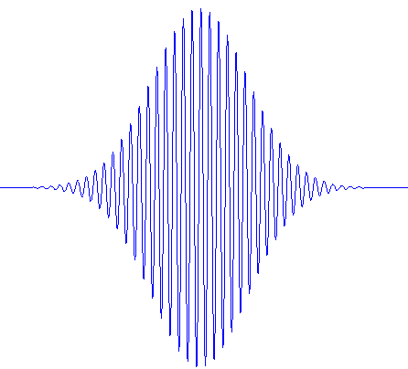
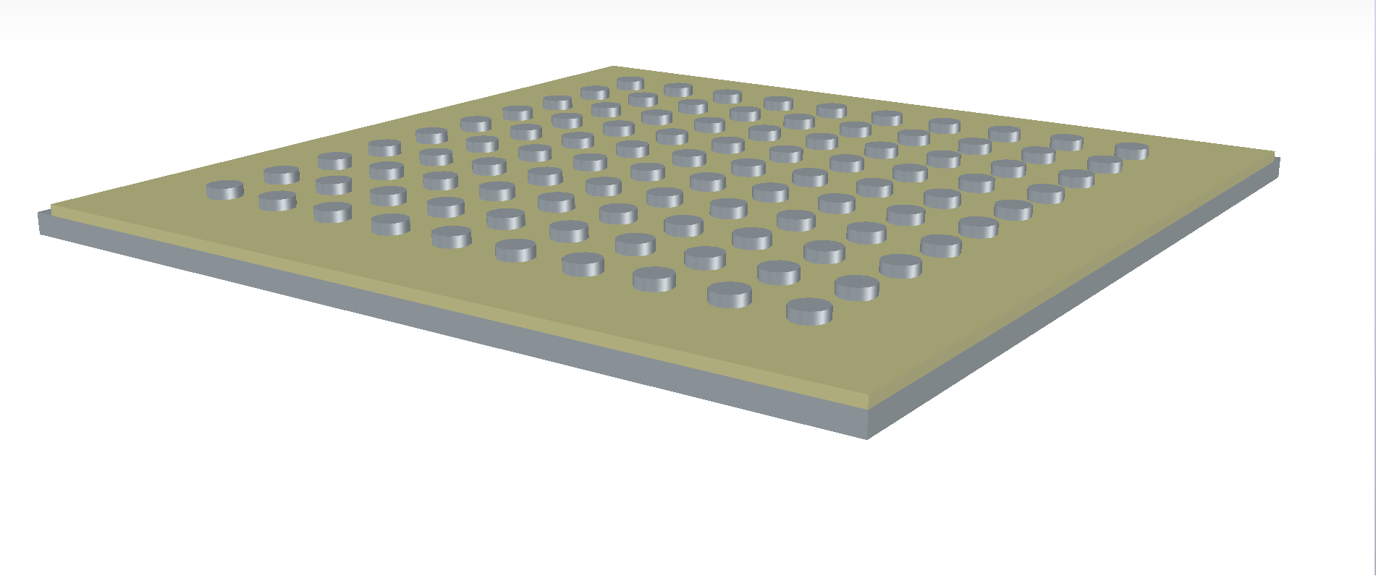
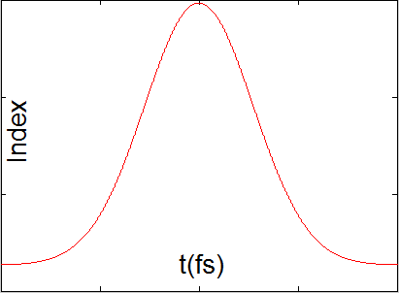
Metasurface saturable absorber mirror using ZrN
Field intensity dependent refractive index (large third order kerr type nonlinearity) of the spacer dielectric
Spacer index change will change the reflectivity of the metasurface (depth of modulation for SAM)
ZrN (refractory) can be pumped with much higher power
Preliminary results of observing the pulse narrowing effect using COMSOL multiphysics.
Incident pulse
Reflected pulse
ZrN antennas
ZrN mirror
Spacer with Kerr type nonlinearity

Slide 7
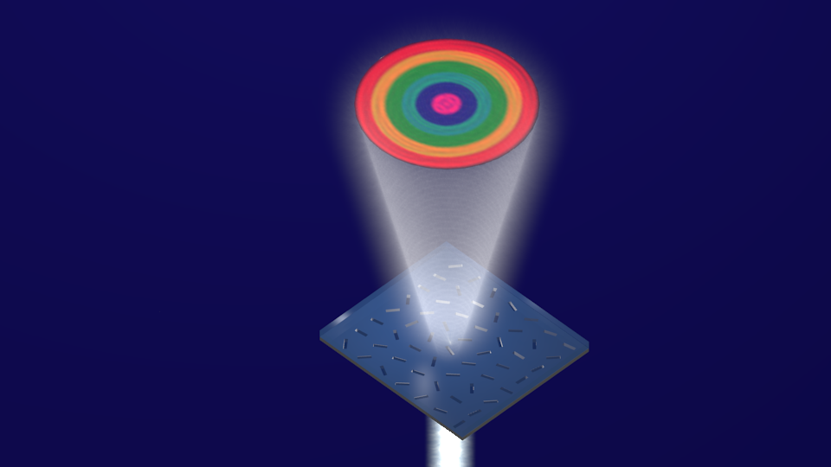
Experimental Progress for Color Hologram
Sajid Choudhury, Amr Shaltout, Alexander Kildishev, Vladimir Shalaev, Alexandra Boltasseva

Slide 8
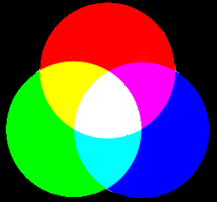
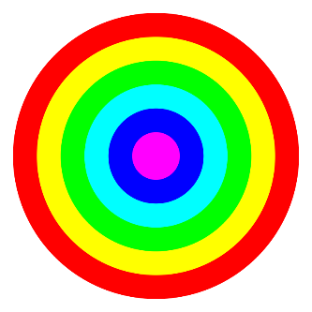
SEM Image of Patterns created with FIB
- Sample: Ag-40nm Ebeam Evaporated on Fused Silica substrate
- Pattern Written with Focused Ion Beam

Slide 9
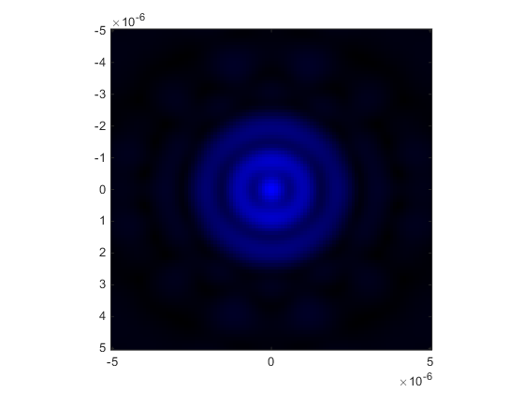
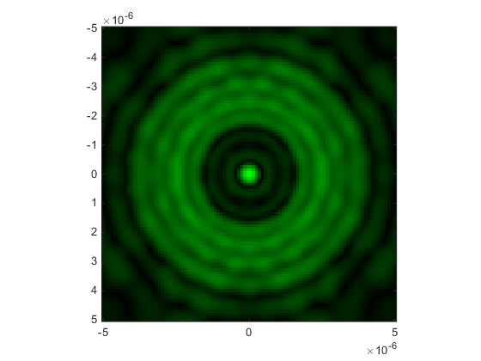
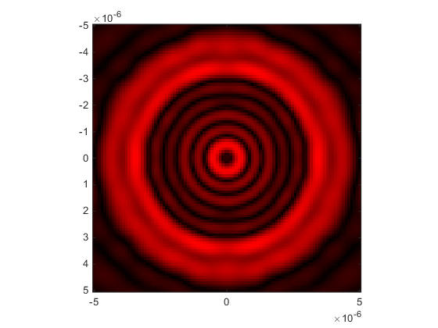
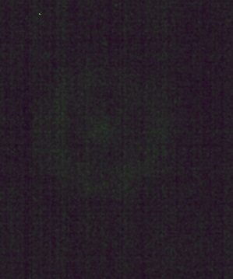
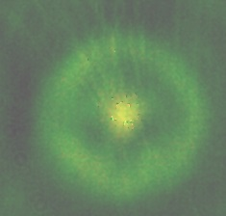
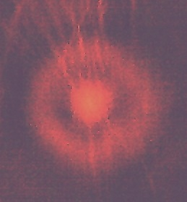
RGB Images for the Hologram Pattern
Simulation
Experiment
Sample illuminated separately with Ar-Kr laser, and Super-K Laser (with help of Nate Kinsey) and pattern observed using CCD Camera.

